Slide 1
Project 2 :
NLP Challange

Slide 2
NeuralLens Group :
Renad Almaghthawi
Lina Alshammari
Renad Asiri

Slide 3

Introduction
Project Name
NLP Challenge – Fake News Detection
Objective:
Build a machine learning model to classify real vs. fake news articles
Tools Used:
Python, Pandas, Scikit-learn, NLTK

Slide 4
Dataset Used: Fake news dataset with labeled articles.
Features:
Title (headline of the news)
Text (full content of the article)
Subject (category of the news)
date (publication date of the article).
Label: 1 = Real, 0 = Fake
Data Exploration
Dataset Size:
39942 total articles
Class Distribution:
Fake News: 19943
Real News: 19999
Missing Values: Checked
Dataset
overview

Slide 5
Preprocessing Steps
Text Cleaning:
Removed punctuation & special characters
Converted text to lowercase
Tokenization & Vectorization: TF-IDF and Word2Vec are used for feature extraction.
Stopword Removal: Filtered out common words
Stemming vs. Lemmatization: Used Lemmatization for better context preservation
N-grams: Used unigrams & bigrams to capture word relationships
Data Pre-processing

Slide 6
Classical NLP Models
Naïve Bayes
Logistic Regression
SVM

Slide 7
TF-IDF + Classical Classifiers
Models Tested:
Naïve Bayes: 94.32% Accuracy
Logistic Regression: 98.81% Accuracy
SVM: 99.45% Accuracy (Best Model)
We choose SVM as the best model. why?
Handles high-dimensional data well.
Works effectively with TF-IDF features.
Training & Evaluation

Slide 8
max_features , ngram_range Experments (best model : SVC)
max_features | ngram_range | Accuracy
1000 | (1,1) | 98.96%
1000 | (1,2) | 99.17%
3000 | (1,1) | 99.24%
3000 | (1,2) | 99.45%
5000 | (1,1) | 99.21%
5000 | (1,2) | 99.40%

Slide 9
Word2Vec-Based Models
SVM
Kim’s CNN

Slide 10
Pre-trained Word2Vec embeddings from Google News
Feature Extraction :
max_features= 3000, Keep the 3000 most frequent words
ngram_range=(1,2) # Use both unigrams and bigrams
SVM
SVM with Word2Vec Accuracy: 85.64%
Comparison with TF-IDF + SVM:
Word2Vec loses contextual details when averaging embeddings.

Slide 11
Why CNN for NLP?
Extracts spatial relationships between words.
Captures phrase-level meaning effectively.
Model Architecture:
Three channels:
Static: Pre-trained Word2Vec (frozen).
Non-Static: Fine-tuned Word2Vec.
Random: Trainable embeddings.
Convolution Layers with multiple filter sizes (3,4,5).
Max-pooling & Fully Connected Layers.
Final Accuracy: 99.89%
Kim’s CNN

Slide 12
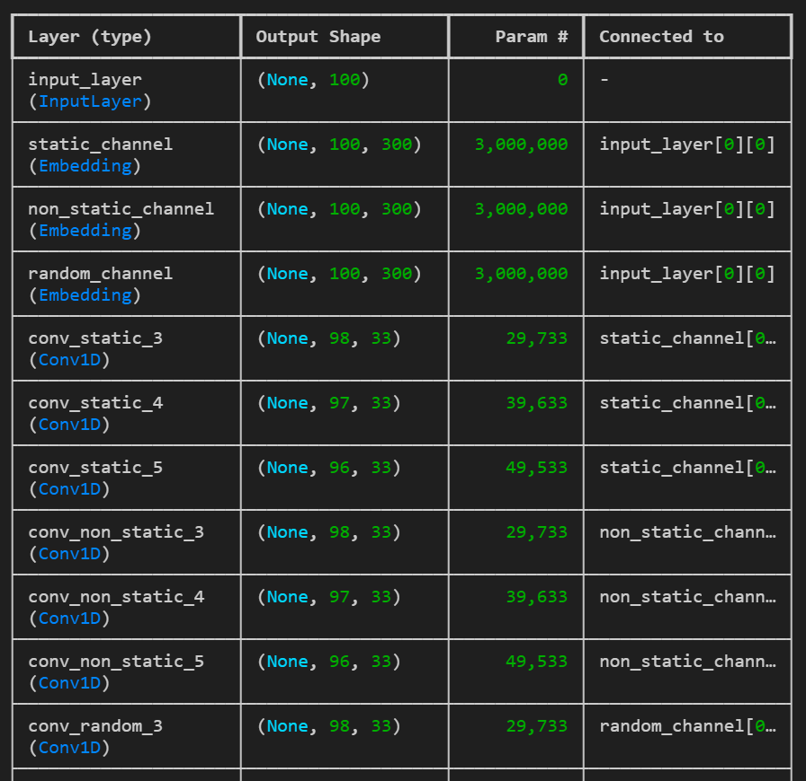
Kim’s CNN

Slide 13
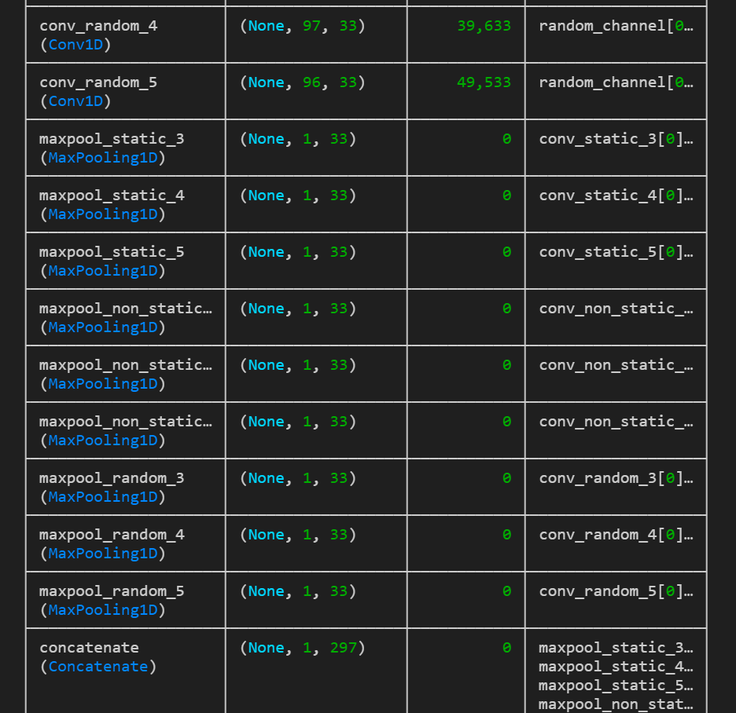
Kim’s CNN

Slide 14
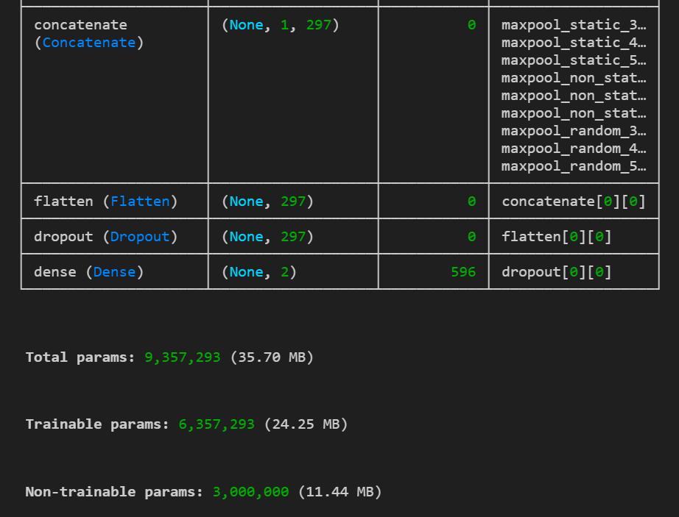
Kim’s CNN

Slide 15
Model Comparison
Model | Feature Extraction | Accuracy
Naïve Bayes | TF-IDF | 94.32%
Logistic Regression | TF-IDF | 98.81%
SVM | TF-IDF | 99.45%
SVM | Word2Vec | 85.64%
Kim's CNN | Word2Vec | 99.89%

Slide 16

Conclusion
Key Takeaways:
TF-IDF + SVM is simple & effective.
Deep Learning (CNN) achieves the best accuracy but requires more resources.
Word2Vec embeddings may lose context in classical classifiers.
https://nlp-neurallen.streamlit.app/

Slide 17
Thank You!

